Slide 1

Cybersecurity analysis
Are there any vulnerabilities in your production server?
Elaine R. Constancio
Quickstart
Cybersecurity Bootcamp
Project C

Slide 2
Summary
how safe is your production and Operations server?
To determine how safe your production server and Webserver was we first had to determine if it was set up properly by preforming a simple configuration scan to confirm the Ip address and settings. Once that was done, we were quickly able to break into the server individually and setup a secure shell with excelled privileges using simple vulnerability scanning tools such as metaspoilable2. With this higher privilege we exposed the first vulnerability and additional ones such as, setting up a new user account with a specific password that has root privileges and making the password more difficult to be broken by brute force or with a simple wordlist and adding a comma just to mess with csv file the password would be stored in and preventing any dictionary breaks easily. All details are displayed in the following slides with images. Please be advised that this was done by an ethical hacker professional for this vulnerability scan purposes only. Finally, once all the scans were done, we discovered more than 50 vulnerabilities as shown in the images. We exploited 4 of those efficiently and were able to get an active shell session set up shop and check all the files on the server; one being the reset_log.sh file to erase our tracks. Thanks for that!

Slide 3
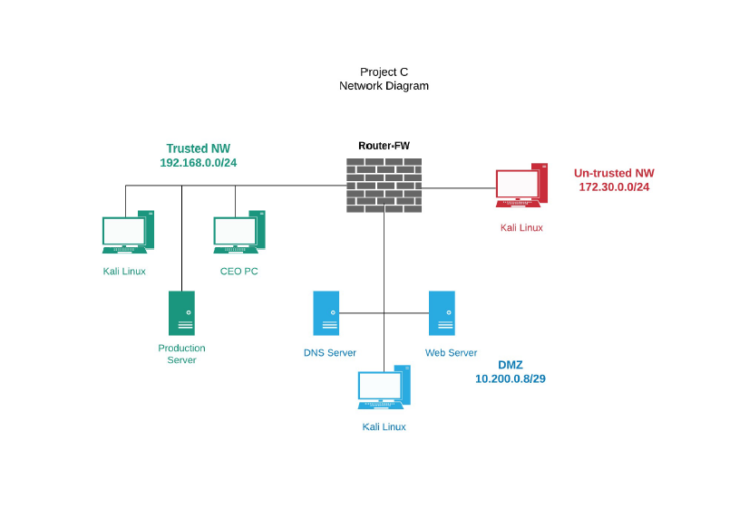
Network diagram

Slide 4

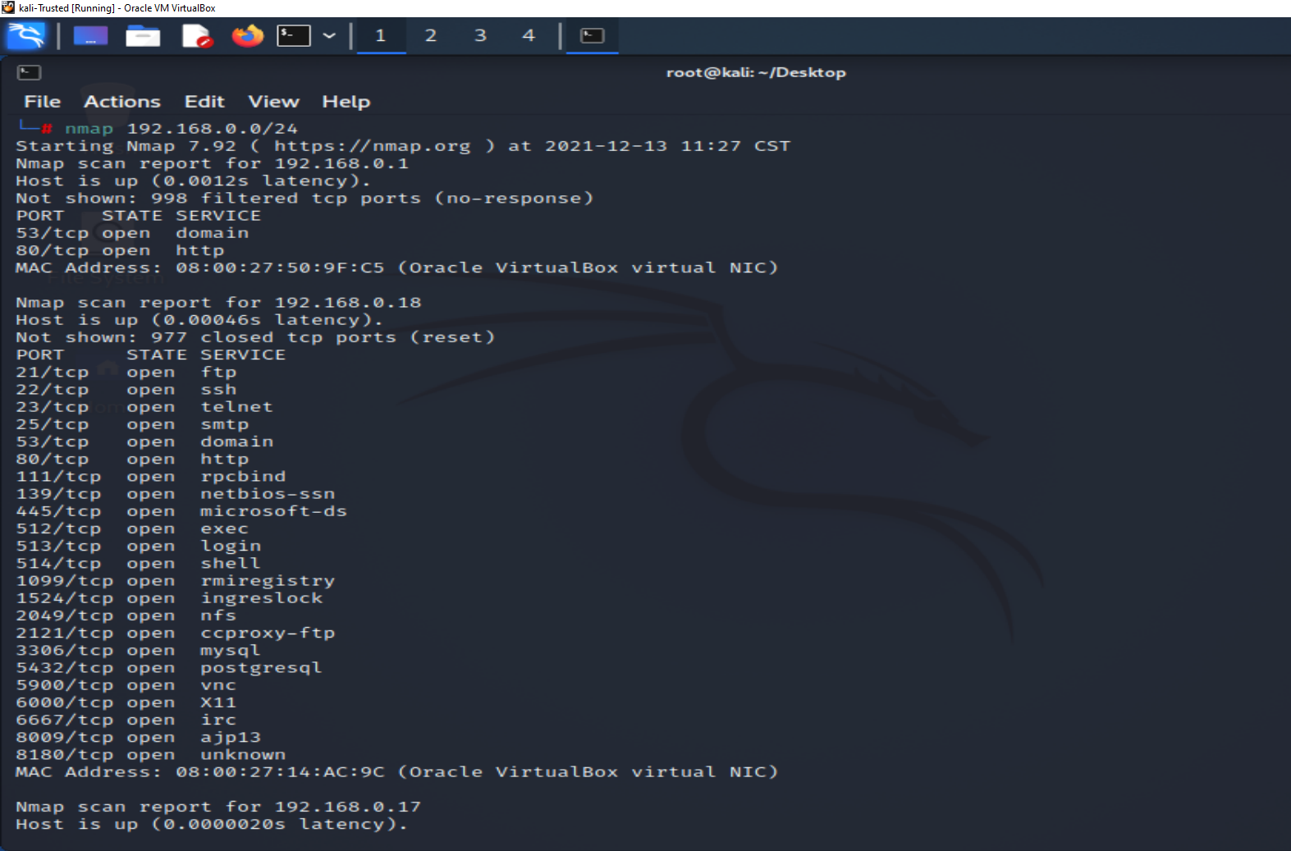
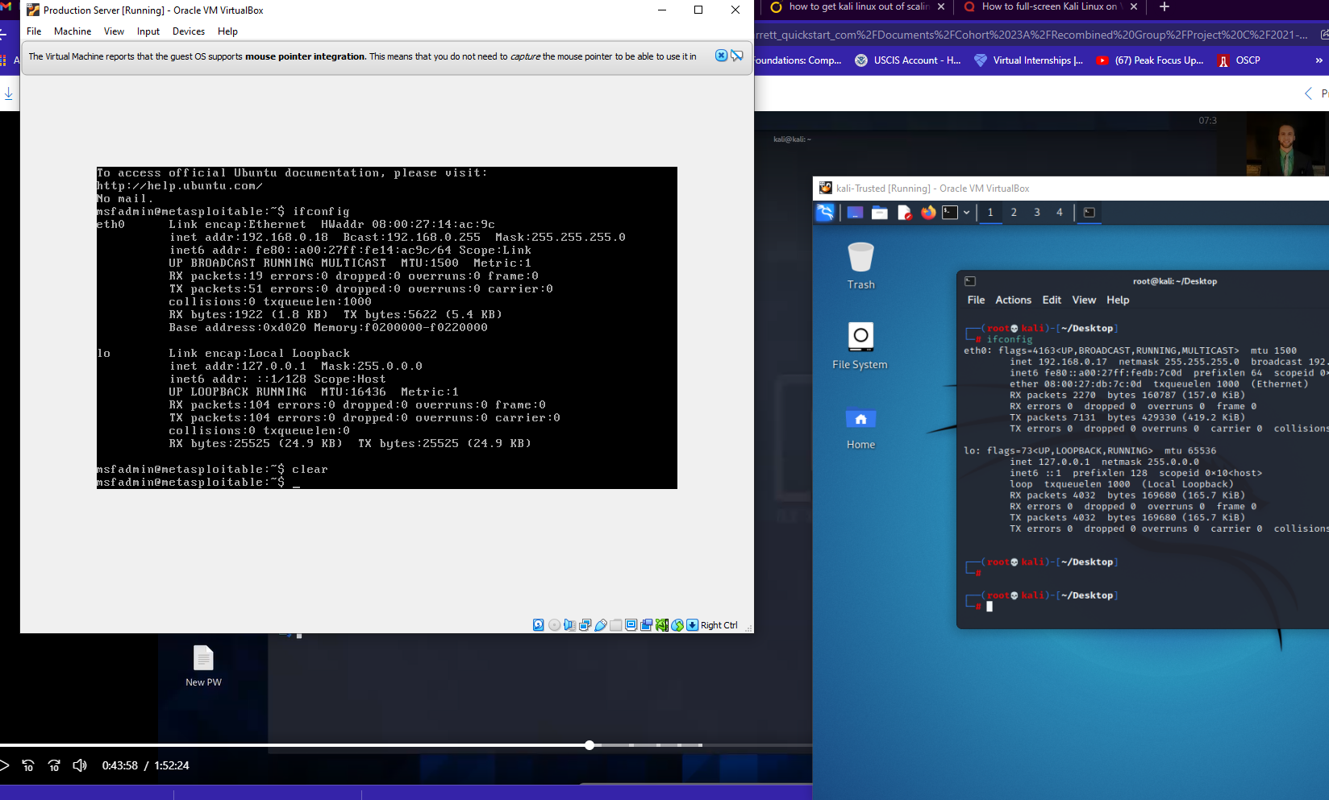

NMAP scan of Production server
IP Address for Production Server &

Slide 5
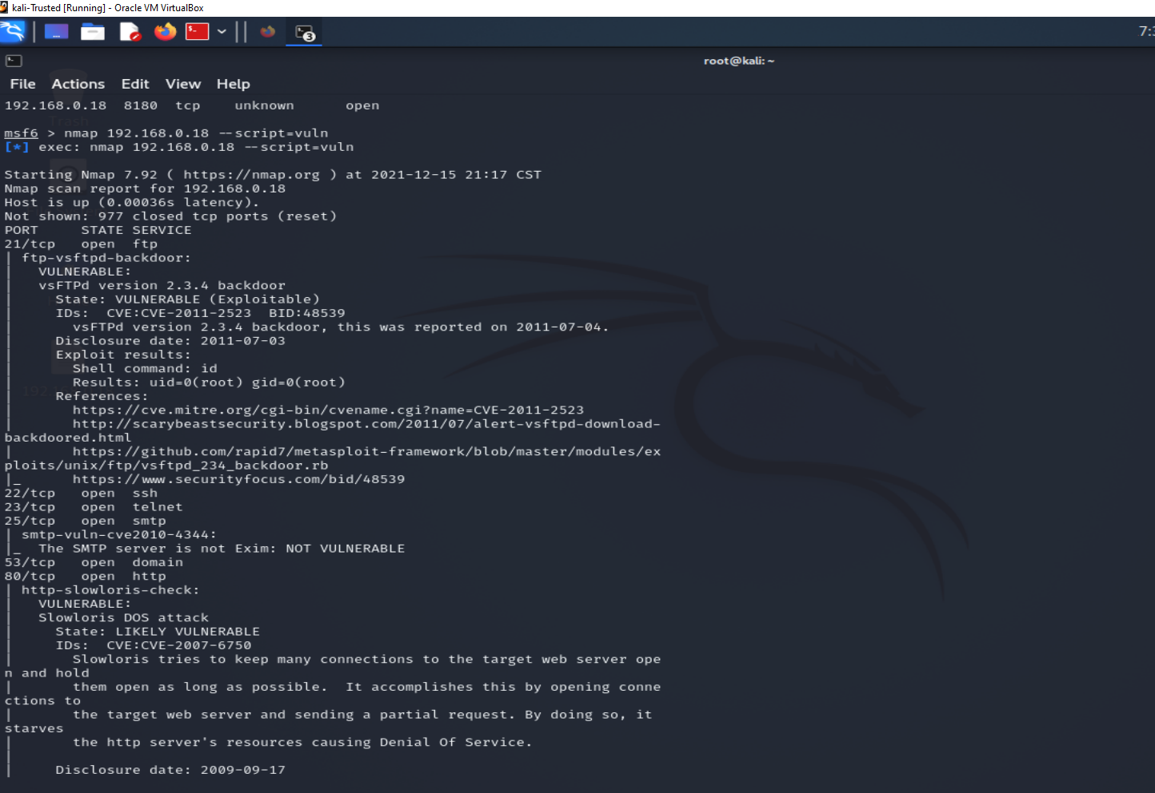
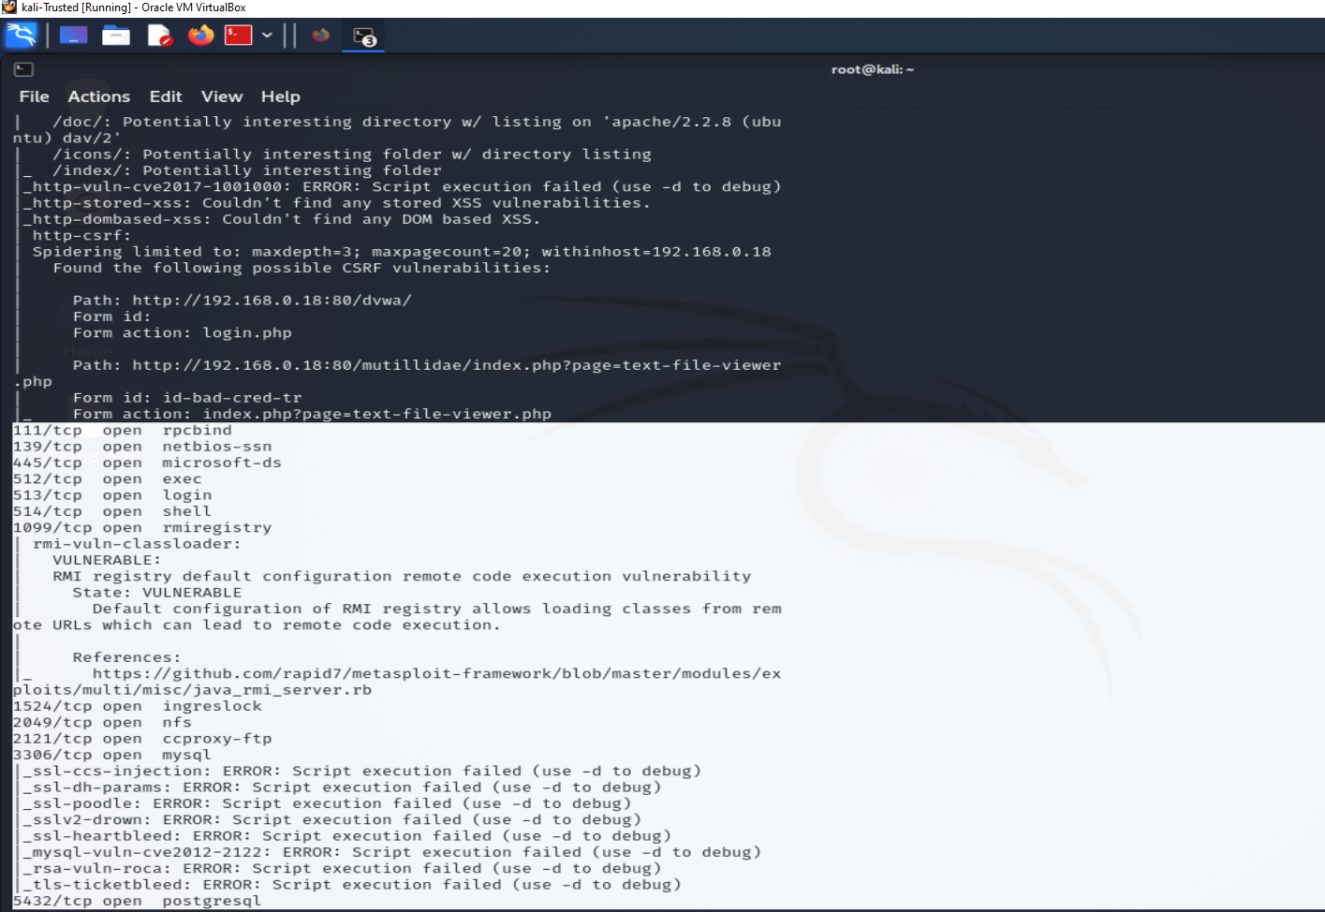
Production Server: Nmap Script used for vuln scan –script=vuln
As you can see With this vulnerability command, we were able to discover all vulnerabilities on the production server.

Slide 6
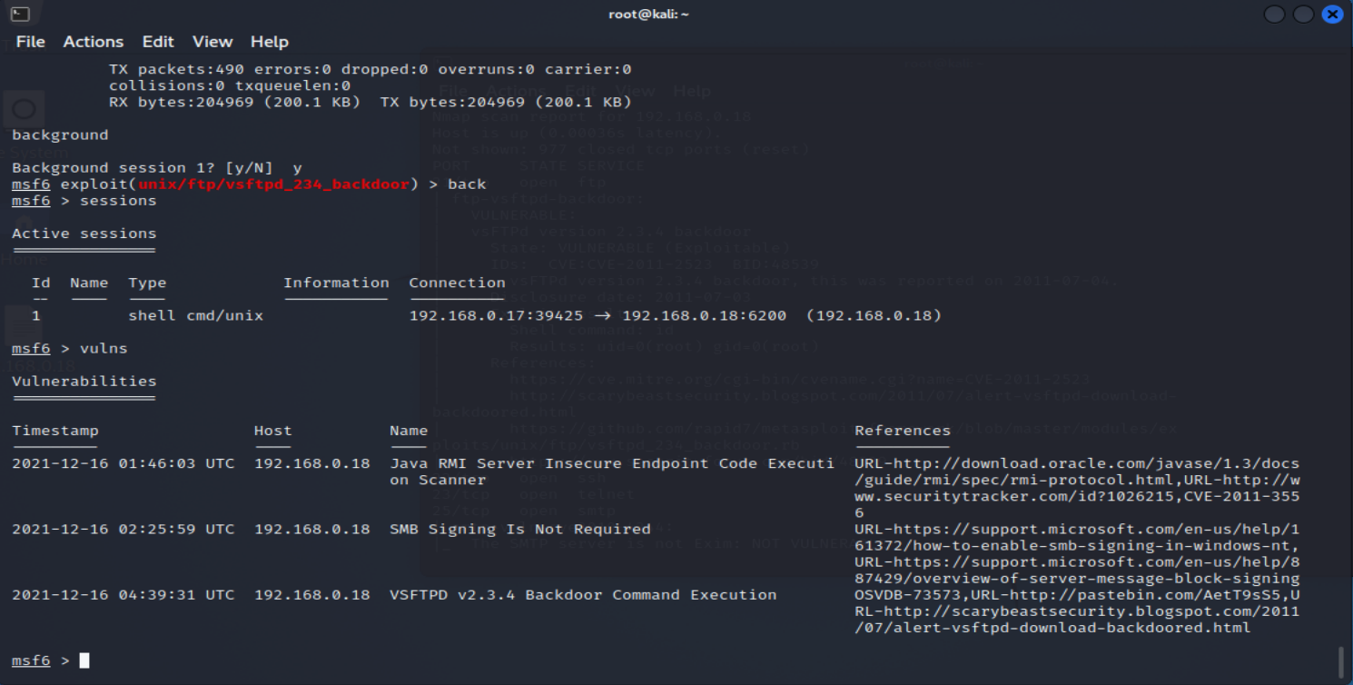
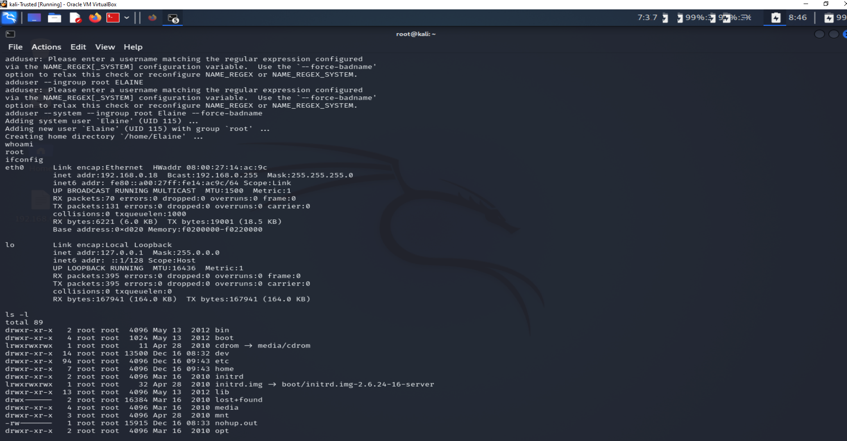
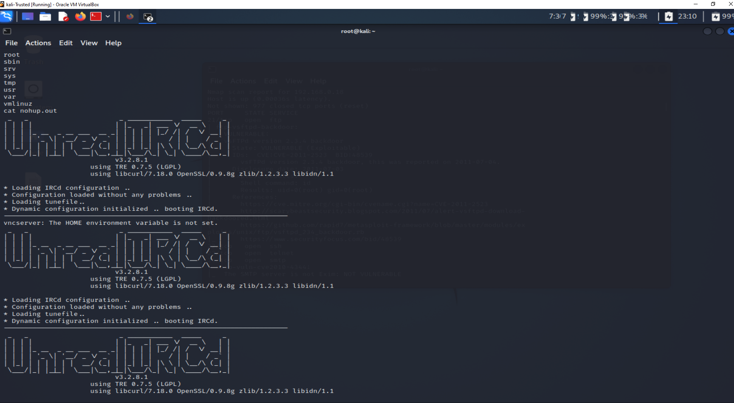
exploit performed for Production Server
3 vulns & Shell access
Showing root access
Accessing file on server as root

Slide 7
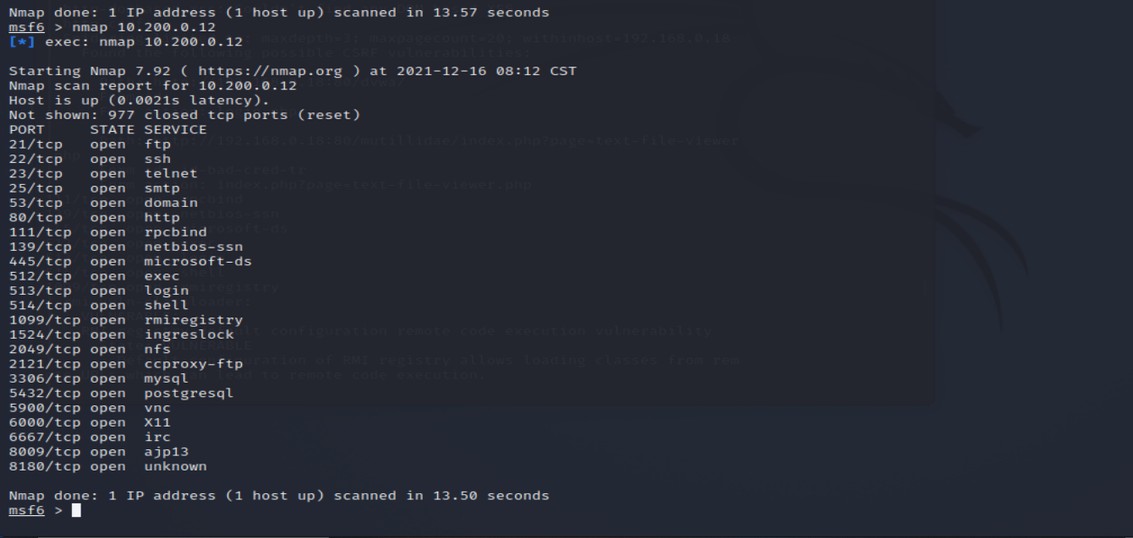
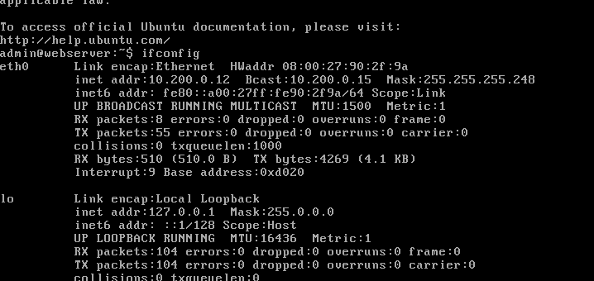
Nmap Scan of Webserver
Ip Address for Webserver &

Slide 8
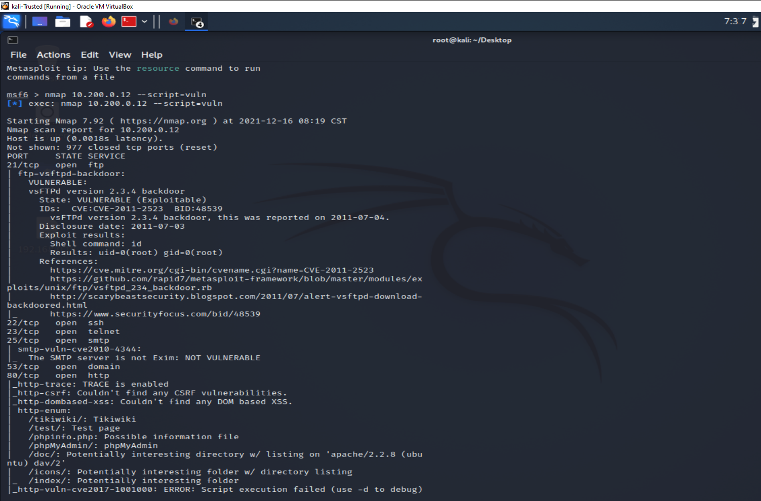
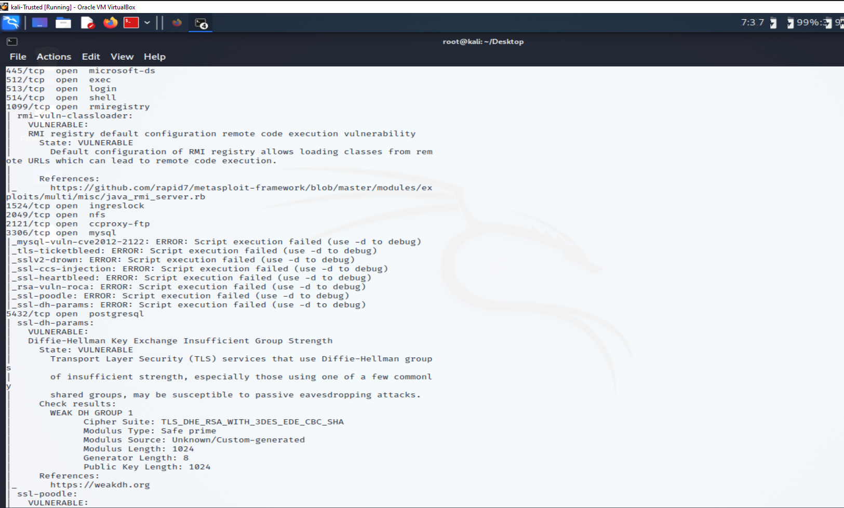
Webserver vulnerabilities

Slide 9
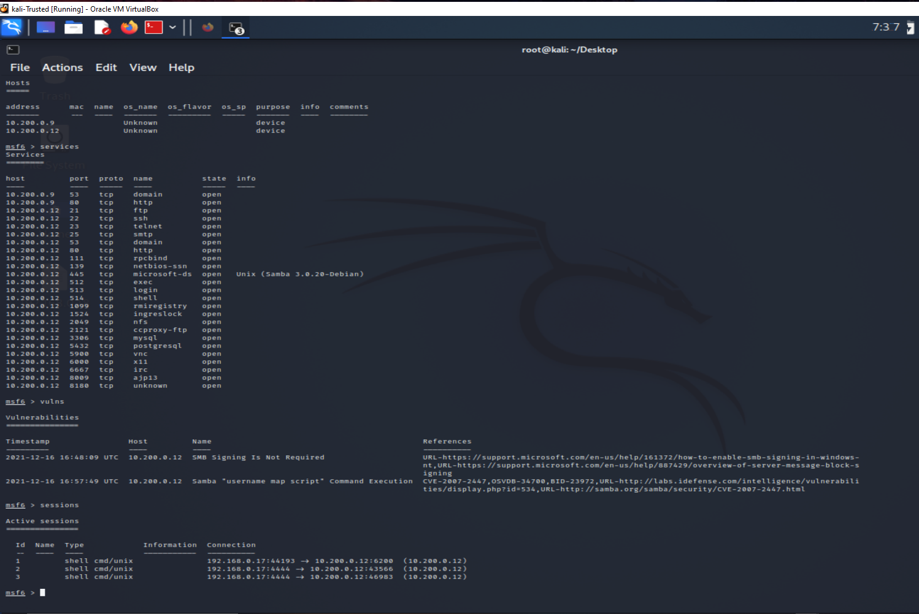
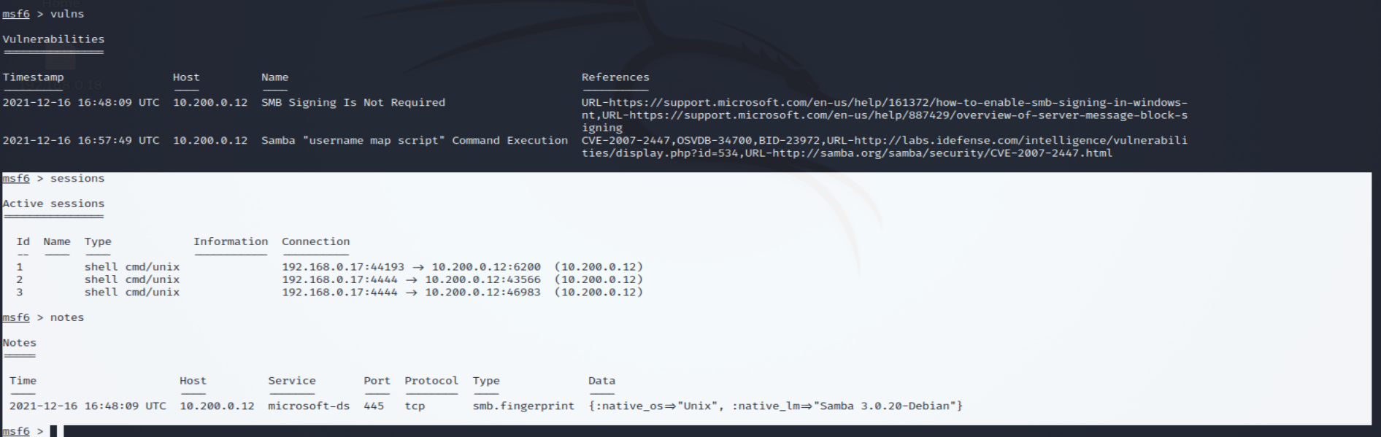
Exploit performed on Webserver
As you can see, we have 2 different exploits on this server.
1. thru the command execution we set up a shell access in root privilege and even added a user

Slide 10
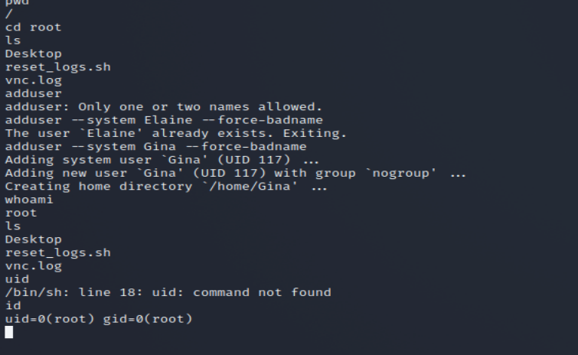
Exploits performed
1.Set up shop with secure shell access with root privileges
2.Created a couple of root access users!

Slide 11
Recommendation's
Do not use telnet port 23 for remote connections as it’s one of the oldest protocols that do not provide any digital privacy as all the username and passwords sent between computers are in plain text, therefore leaving it extremely vulnerable to MITM (man-in-the-middle) attacks.
Disable the server signature. “Attackers, begin to probe a web server for possible exploitation is by sending a remote request that pulls back valuable information served up by the server signature” (infosecinstitute.com). Without this signature , less exposure.
Ensure you have valuable patch system in place and consistently check it.
Hire an experienced professional such as our company to continue to harden your network and properly configure all your settings!
Thank you for this opportunity and please call us with any questions!

